Slide 1
ConnectBud
Python
Class 1
By: Rahul Joshi

Slide 2
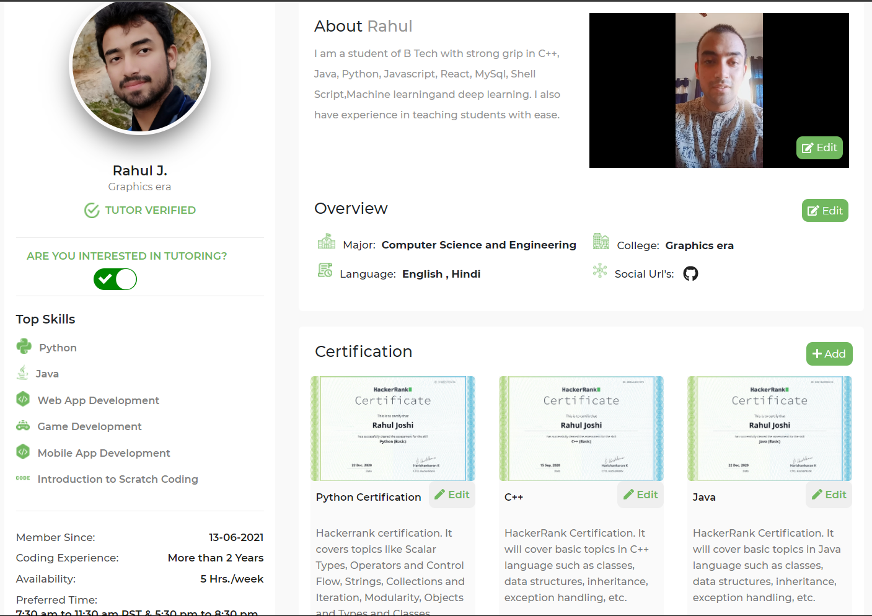

Slide 3
Course Overview
Class 1: • Introduction of Python Language
• Installing Python

Slide 4
Introduction
Python is a functional Paradigm.
Eg.
C used structural, java uses object oriented!
Python uses Interpreter.
Compiler. It compiles whole code and then produces output.
Interpreter : It executes each line separately.
Guido van Rossom, 1989, released version 1991.

Slide 5
Why Python?
Python is used for ML, AI, DL, language processing.
Cpython for C Python.
Web Development. Django framework
Complex Mathematics operation.
Software development.

Slide 6
Commands
Pwd : path
Python –version : Check the version
cd : Change Directory
cd .. : return to parent folder
cd arav : go inside arav folder.
Mkdir : make directory(creating folders).
ls : list

Slide 7
Notes
3 paradigm
. Object Oriented
. Structural programming
. functional programming
2 programs that run the machine code:
compiler : compiles the whole code once and then runs
interpreter : compiles single line at a time and then runs.
Java -> code [compiled] byte code generated [run] ->jvm(OOP)
C++ -> code [copiler] [linking][loading] [header files] intermediatry code->[copile to machine code] ->run (structral)
Python -> code [copiler] run(functional)
function: keyword having brackets ().

Slide 8
End
For any queries: Contact:
Rahul Joshi rj26280218@gmail.com

